Slide 1
NETWORKs
DR/ Ibrahim Al-Awadi

Slide 2
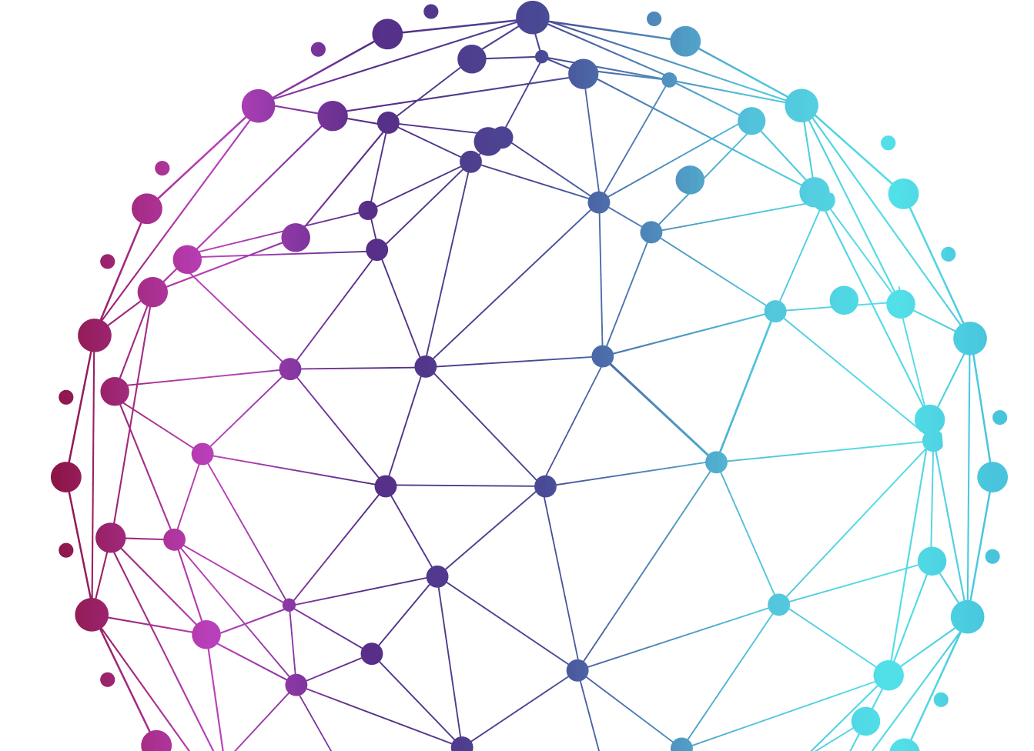
TABLE OF CONTENTS
01
02
E.coli
HOMO
03
YEAST

Slide 3
01
E_coli

Slide 4
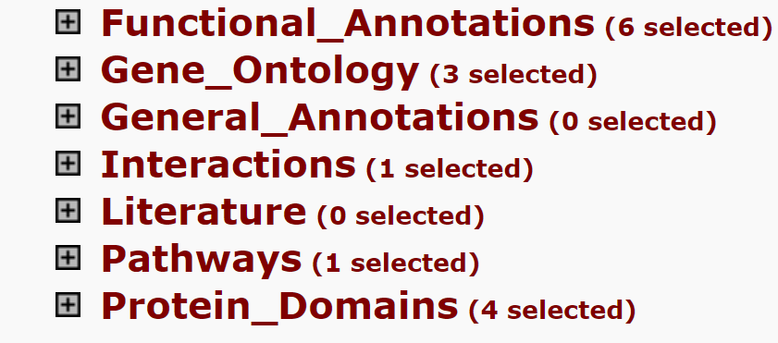
Annotation Summary Results

Slide 5
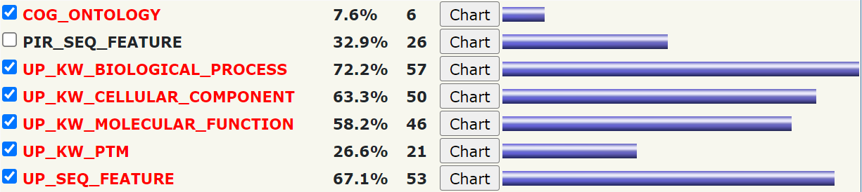
Functional Annotations (6 selected)

Slide 6
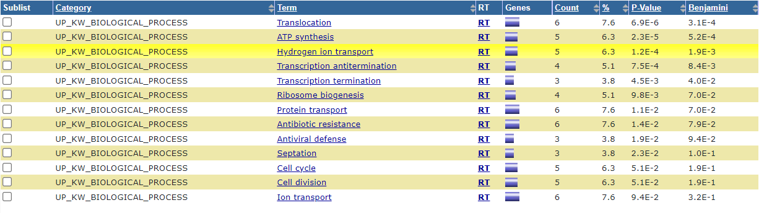
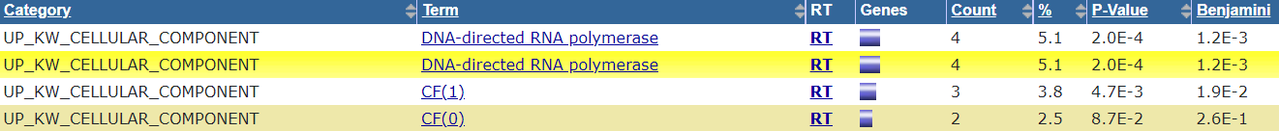
Functional Annotations (charts)
UP_KW_BIOLOGICAL_PROCESS
UP_KW_CELLULAR_COMPONENT

Slide 7
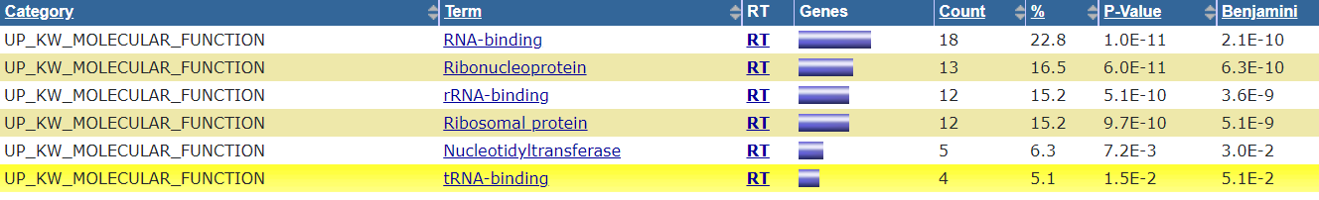
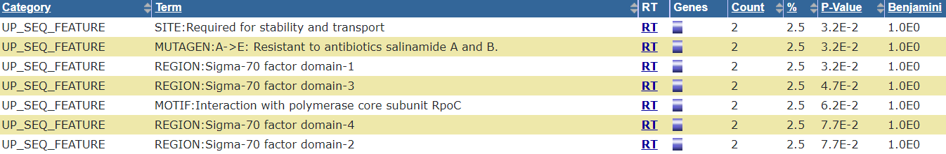

Functional Annotations (charts)
UP_KW_MOLECULAR_FUNCTION
UP_KW_PTM
UP_SEQ_FEATURE

Slide 8
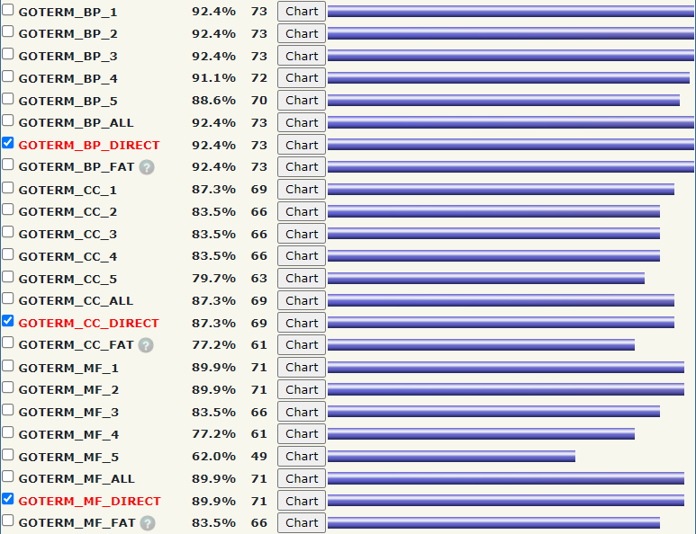
Gene_Ontology (3 selected)

Slide 9
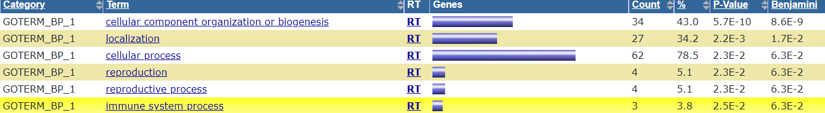
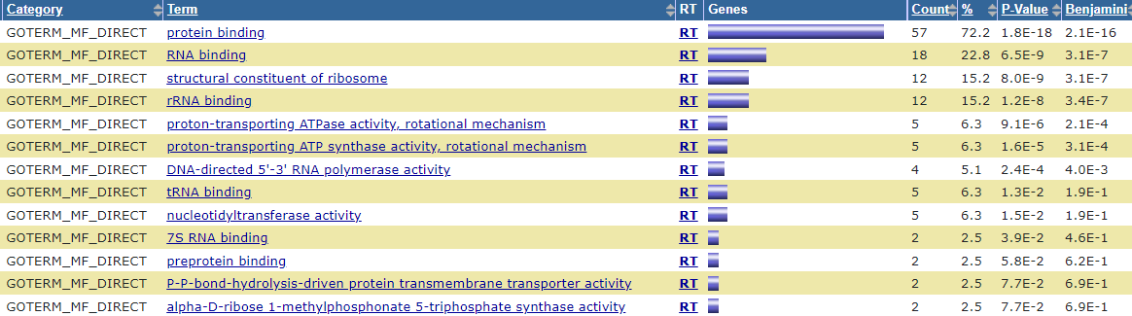
Gene_Ontology(charts)
GOTERM_CC_DIRECT
GOTERM_MF_DIRECT

Slide 10
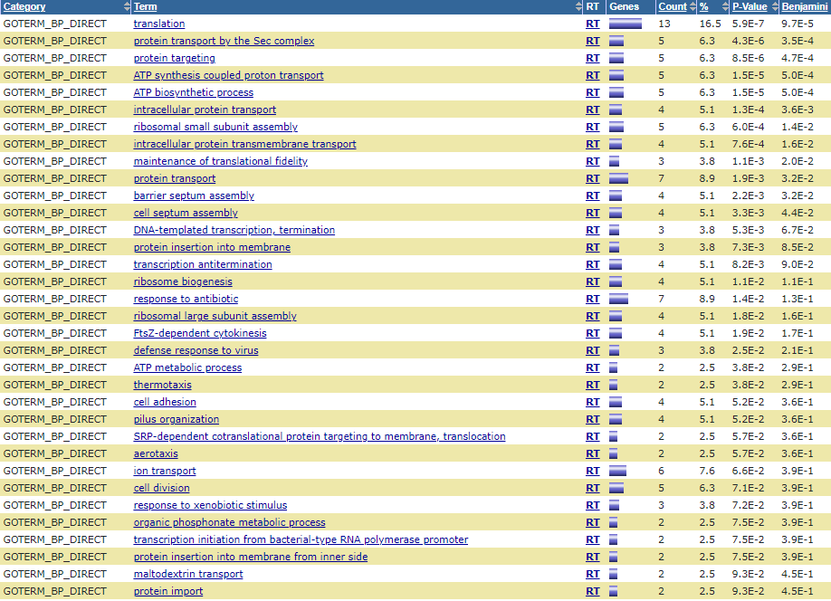
Gene_Ontology(charts)
GOTERM_BP_DIRECT
GOTERM_MF_DIRECT

Slide 11
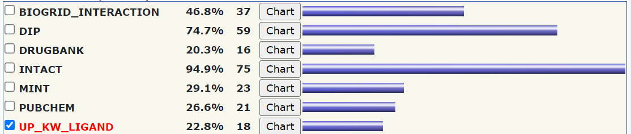
Interactions (1 selected)
NO chart

Slide 12
Pathways (1 selected)

Slide 13
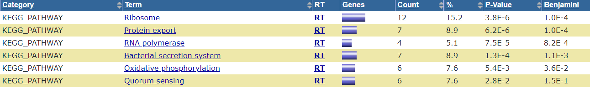
Pathways (charts)
KEGG_PATHWAY

Slide 14
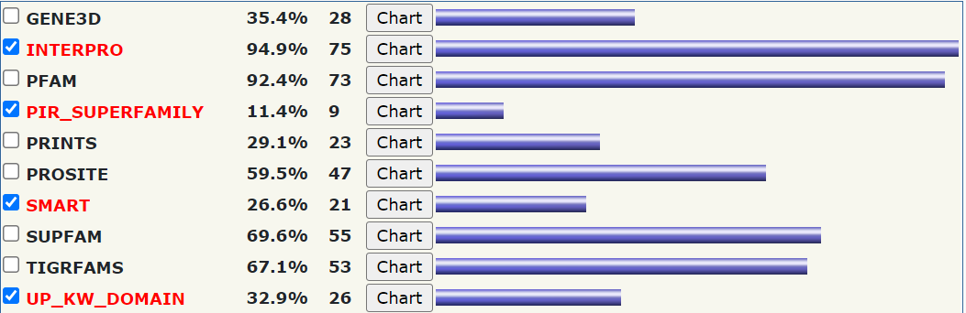
Protein Domains (4 selected)

Slide 15
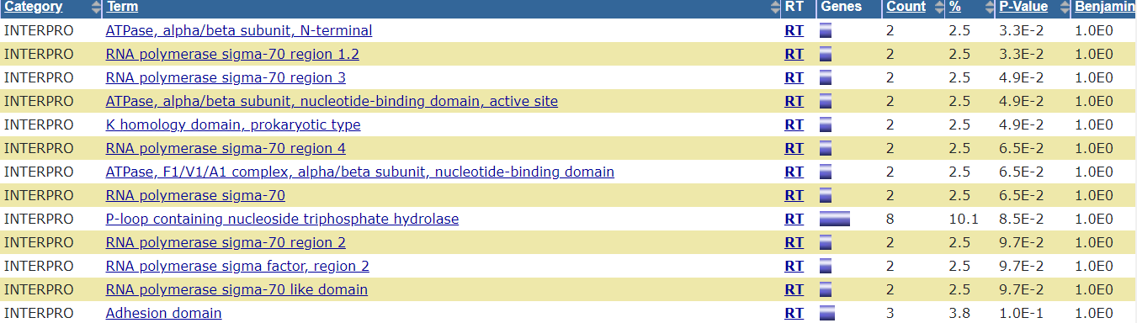
Protein Domains (charts)
INTERPRO
PIR_SUPERFAMILY
SMART
UP_KW_DOMAIN
NO chart

Slide 16
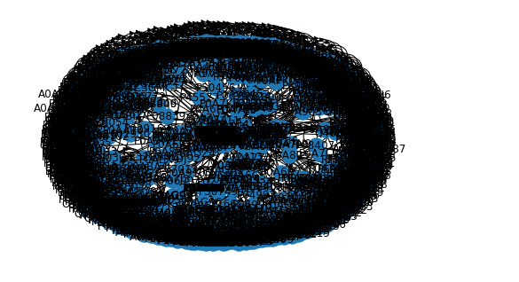
Protein interaction of E-coli
OUTPUTs

Slide 17
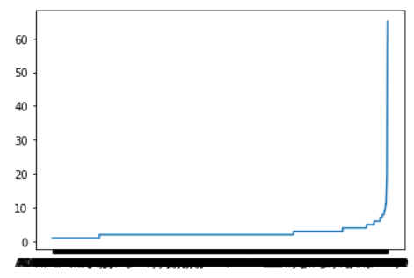
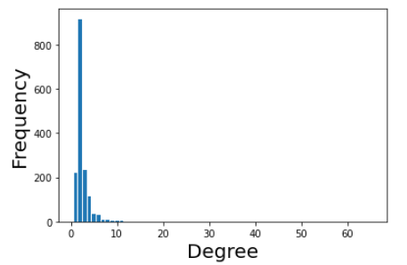
OUTPUTs
visualize to each protein and its degree
frequency for Degrees of proteins

Slide 18
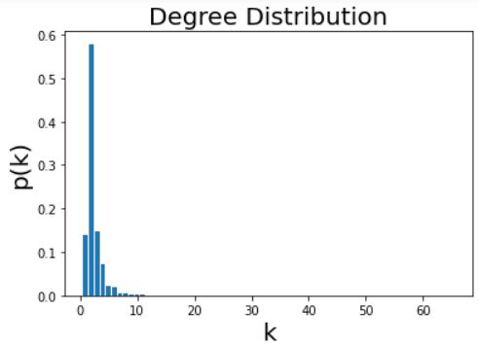
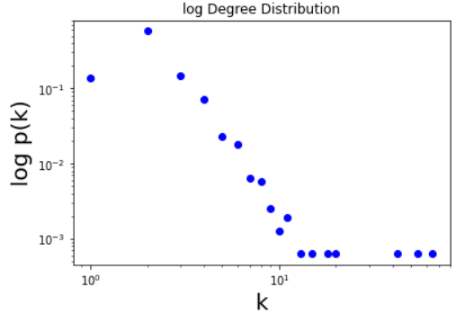
OUTPUTs
Degree Distribution to know hubs (little proteins have high Degree)

Slide 19
02
HOMO

Slide 20
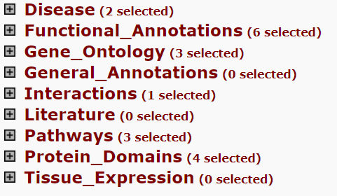
Annotation Summary Results

Slide 21
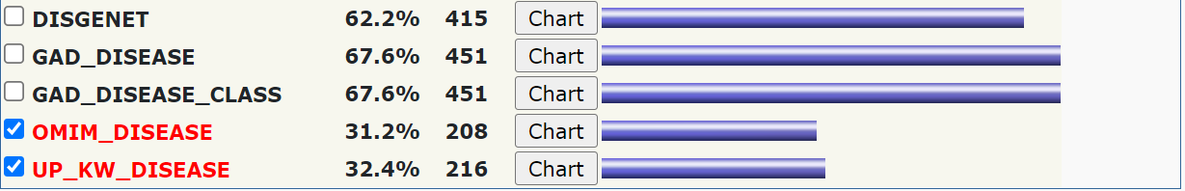
Disease (2 selected)

Slide 22
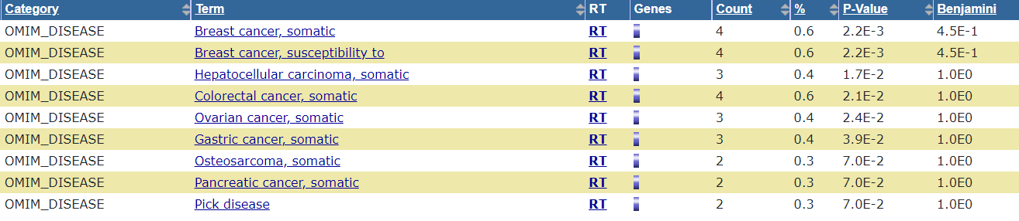
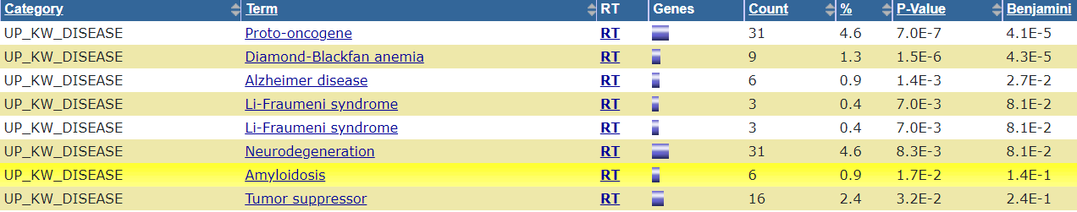
Disease (charts)
OMIM_DISEASE
UP_KW_DISEASE

Slide 23
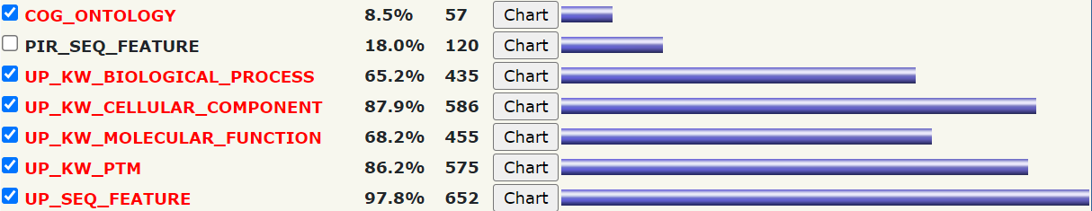
Functional Annotations (6 selected)

Slide 24
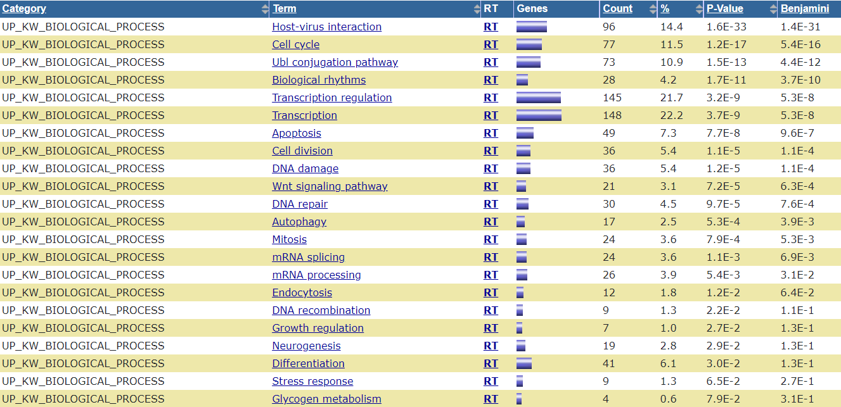
Functional Annotations (charts)
COG_ONTOLOGY
UP_KW_BIOLOGICAL_PROCESS

Slide 25
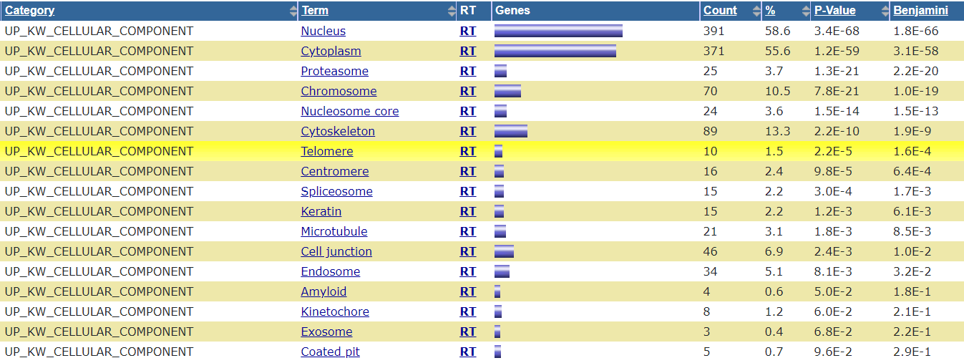
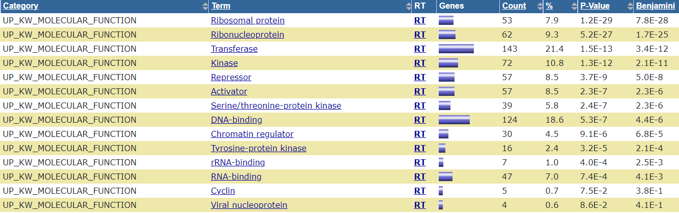
Functional Annotations (charts)
UP_KW_CELLULAR_COMPONENT
UP_KW_MOLECULAR_FUNCTION

Slide 26
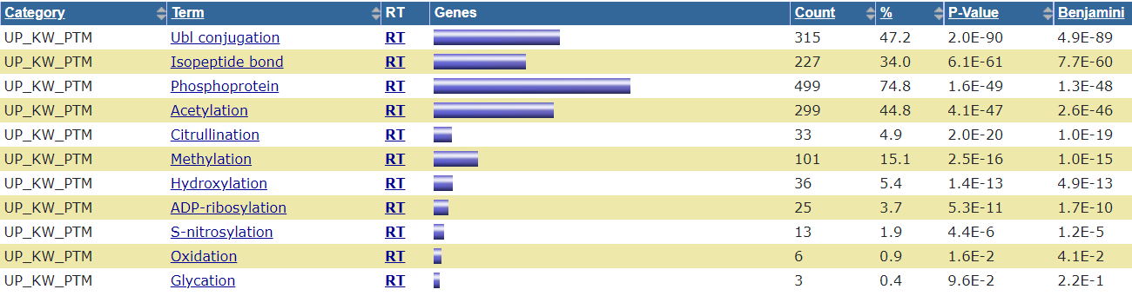
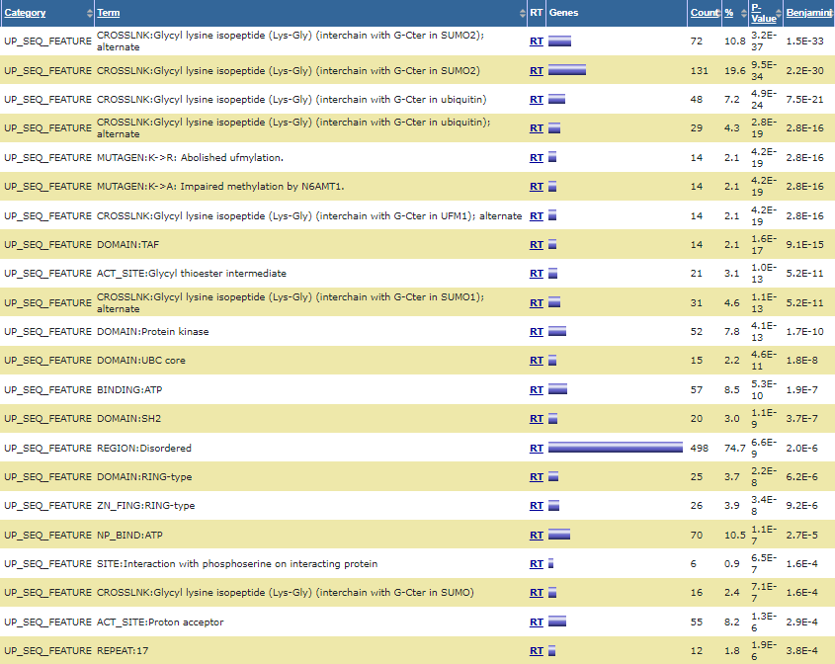
Functional Annotations (charts)
UP_KW_PTM
UP_SEQ_FEATURE(273 chart records)

Slide 27
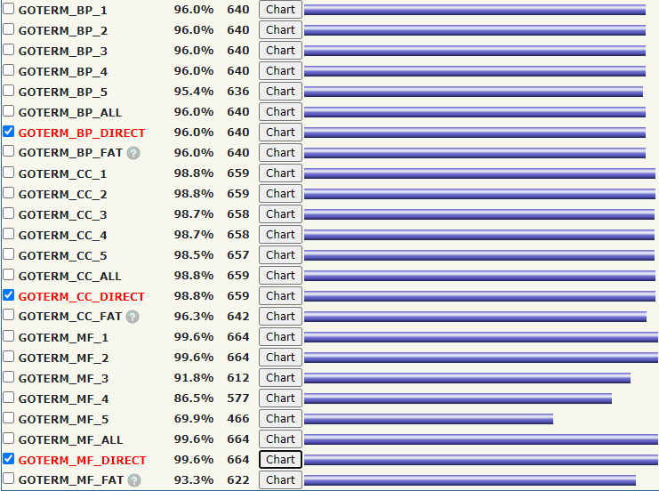
Gene_Ontology (3 selected)

Slide 28
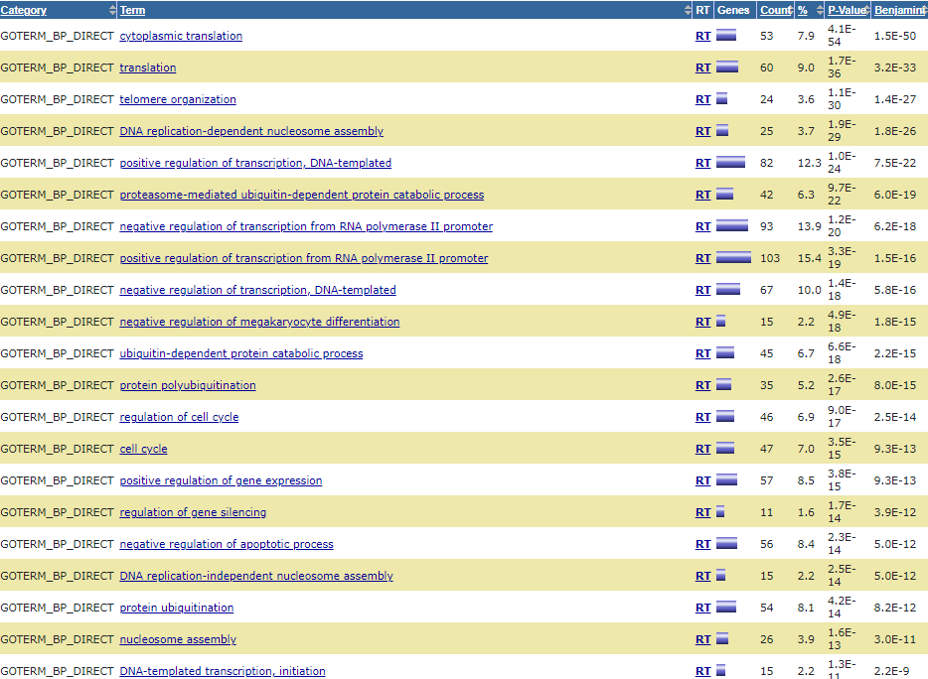
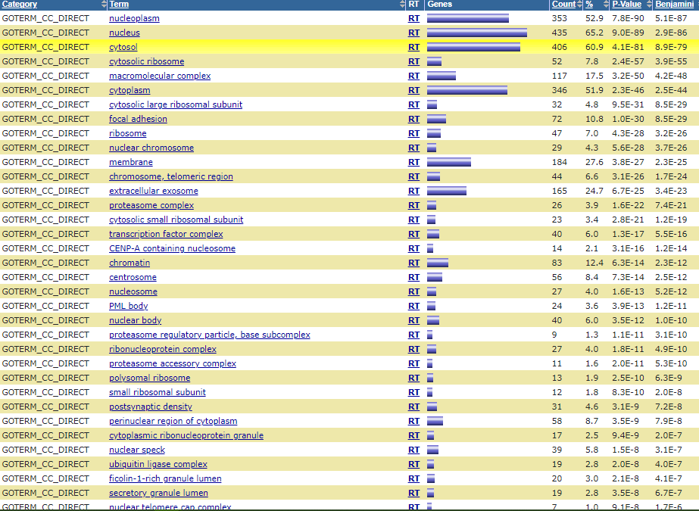
Functional Annotations (charts)
GOTERM_BP_DIRECT (724 chart records)
GOTERM_CC_DIRECT (176 chart records)

Slide 29
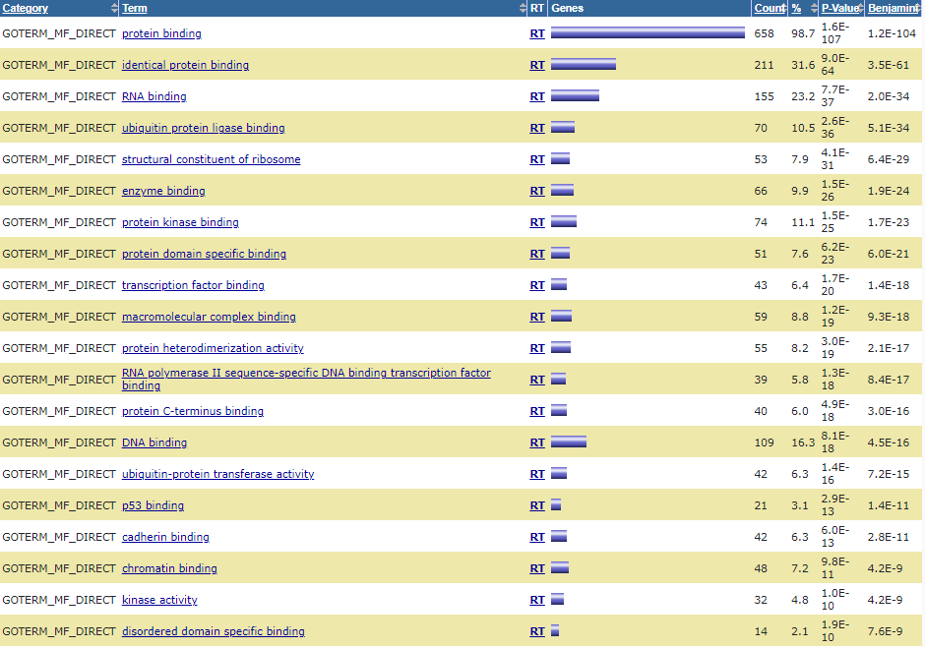
Functional Annotations (charts)
GOTERM_MF_DIRECT (209 chart records)

Slide 30
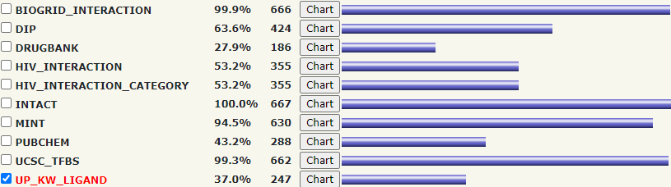
Interactions (1 selected)

Slide 31
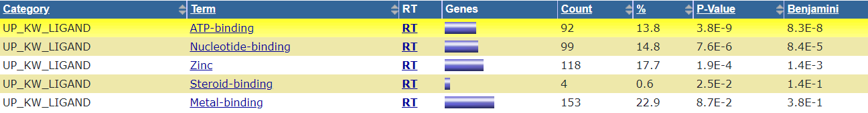
Interactions (charts)
UP_KW_LIGAND

Slide 32
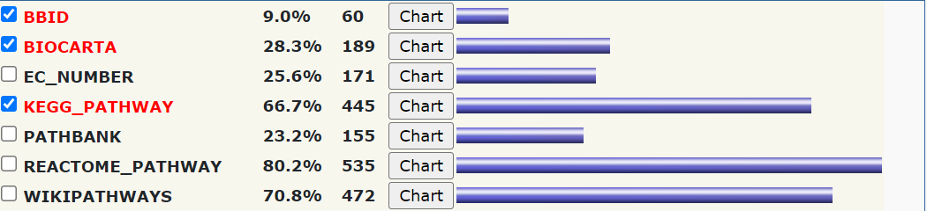
Pathways (3 selected)

Slide 33
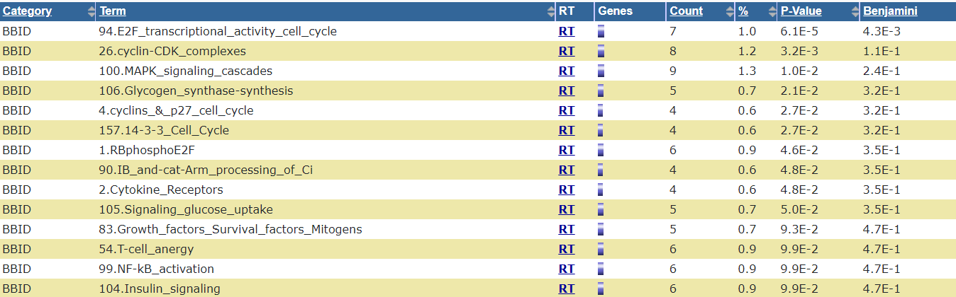
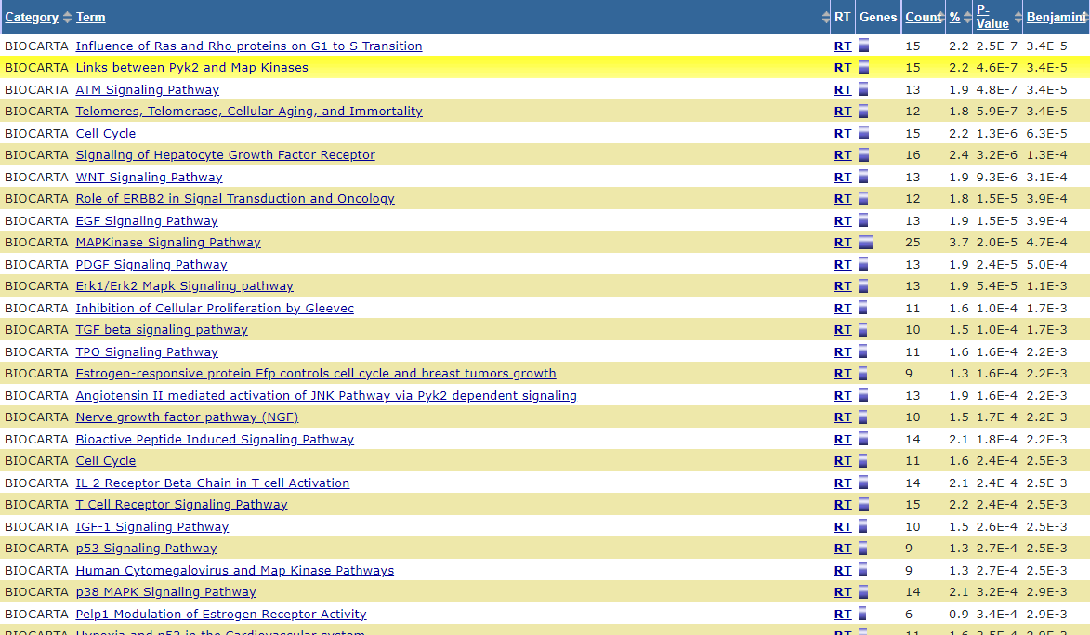
Pathways (charts)
BBID
BIOCARTA(100 chart records)

Slide 34
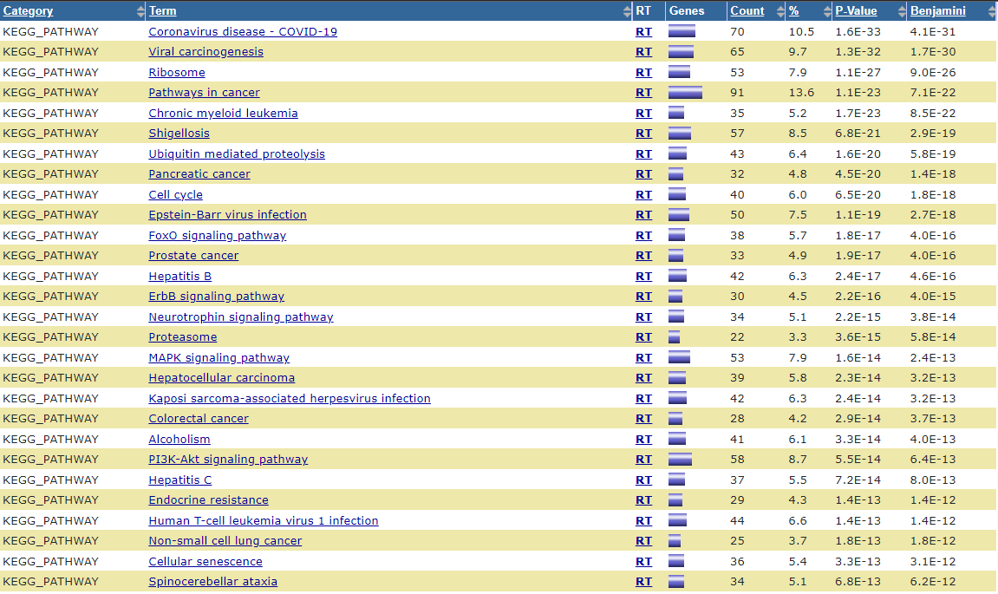
Pathways (charts)
KEGG_PATHWAY (157 chart records)

Slide 35
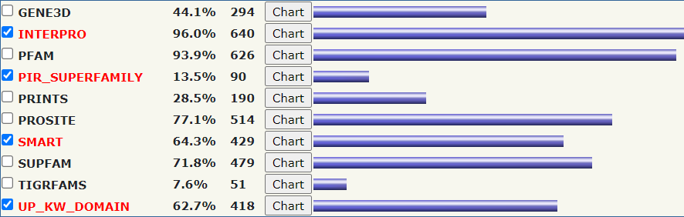
Protein Domains (4 selected)

Slide 36
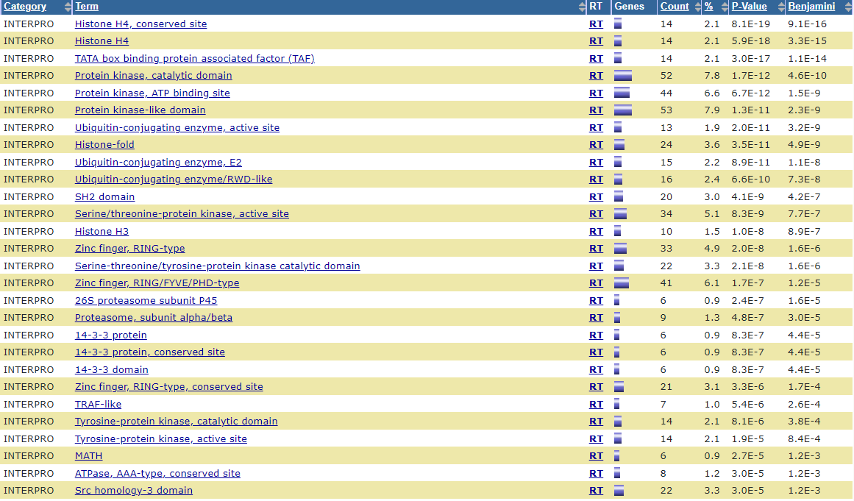
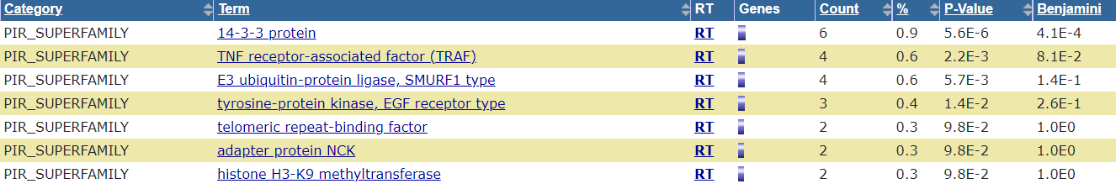
Pathways (charts)
INTERPRO(149 chart records)
PIR_SUPERFAMILY

Slide 37
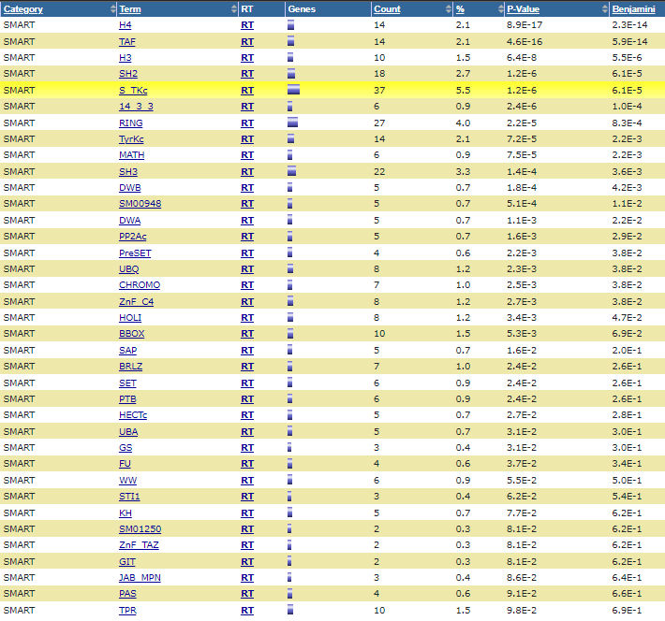
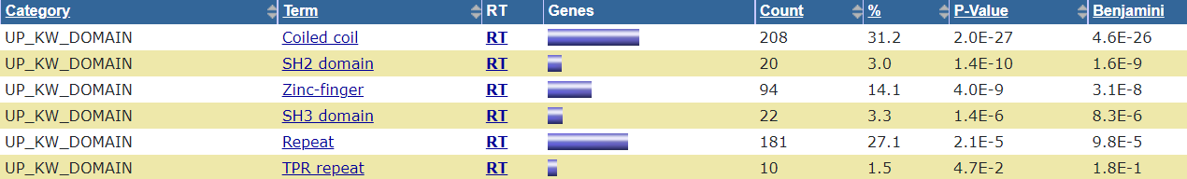
Pathways (charts)
SMART(37chart records)
UP_KW_DOMAIN

Slide 38
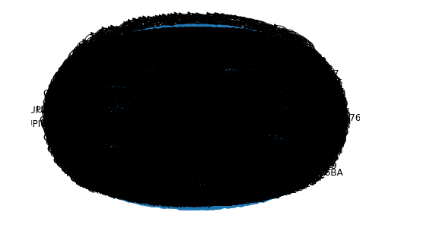
OUTPUTs
Protein interaction of HOMO

Slide 39
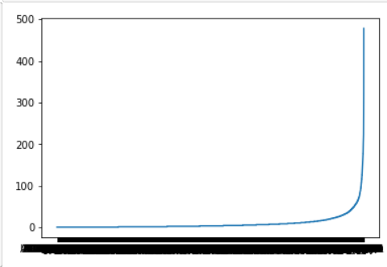
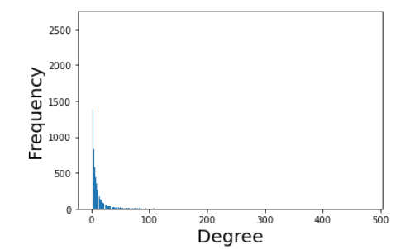
OUTPUTs
visualize to each protein and its degree
frequency for Degrees of proteins

Slide 40
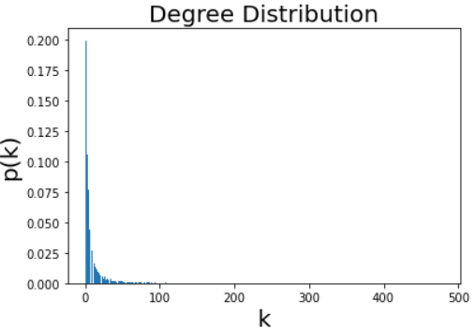
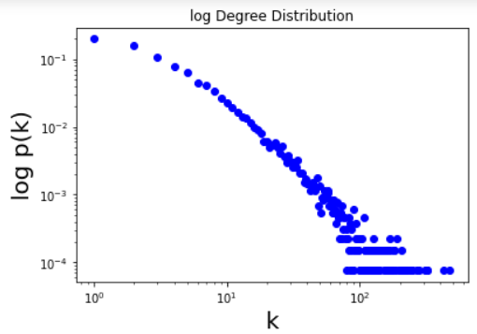
OUTPUTs
Degree Distribution to know hubs (little proteins have high Degree)

Slide 41
03
YEAST

Slide 42


Annotation Summary Results

Slide 43

Functional Annotations (6 selected)

Slide 44

Functional Annotation (Chart)
COG_ONTOLOGY
UP_KW_BIOLOGICAL_PROCESS

Slide 45


Functional Annotation (Chart)
UP_KW_CELLULAR_COMPONENT
UP_KW_MOLECULAR_FUNCTION

Slide 46

Functional Annotation (Chart)
UP_KW_PTM
UP_SEQ_FEATURE

Slide 47

Gene_Ontology (3 selected)

Slide 48

Functional Annotation Chart
GOTERM_BP_DIRECT

Slide 49

Functional Annotation Chart
GOTERM_CC_DIRECT

Slide 50

Functional Annotation Chart
GOTERM_MF_DIRECT

Slide 51

Interactions (1 selected)
UP_KW_LIGAND

Slide 52


Pathways (1 selected)
KEGG_PATHWAY

Slide 53

Protein_Domains (4 selected)

Slide 54

Functional Annotation Chart
INTERPRO

Slide 55

Functional Annotation Chart
SMART
UP_KW_DOMAIN

Slide 56

OUTPUTs
Protein interaction of Yeast

Slide 57


OUTPUTs
visualize to each protein and its degree
frequency for Degrees of proteins

Slide 58


OUTPUTs
Degree Distribution to know hubs (little proteins have high Degree)

Slide 59

THANK YOU

